Slide 1

HOME AUTOMATION
USING
ALICE(A CHATBOT)
BY:-
NAME-Subham Divakar
Department of Electronics & Tele-communication Engineering
C.V Raman College of Engineering, Bhubaneswar
An Autonomous Institute Affiliated to BPUT.

Slide 2
CONTENT
Problem Statement
Introduction
Alice
Block Diagram(Bluetooth to appliance)
Working Principle
Conclusion
References

Slide 3
PROBLEM STATEMENT
With the increasing use of appliances in the house, number of switches and controls have increased as per the needs. So it’s sometimes hectic to get up and switch on and off.
Ex-while working on your laptop you suddenly want to switch on the fan of your room,
We have to move from one place to another to switch on any appliance.

Slide 4
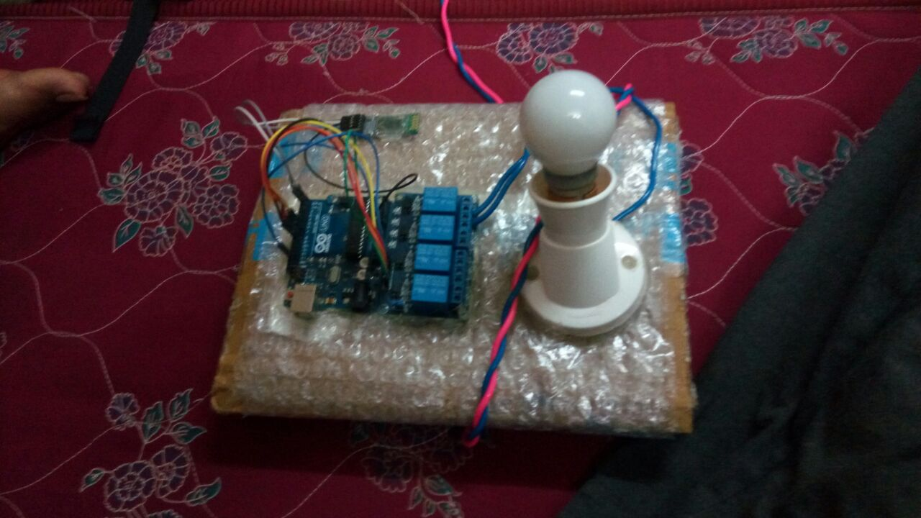

Slide 5
INTRODUCTION
Nowadays, people have smartphones with them all the time. So it makes sense to use these to control home appliances. Presented here is a home automation system using a simple Android app, which you can use to control electrical appliances with clicks or voice commands.
Commands are sent via Bluetooth to Arduino Uno. And the final switching purpose is fulfilled by relay switches controlled by the microcontroller.

Slide 6
ALICE- A CHATBOT
What is a chatbot?
chat robot, a computer program that simulates human conversation, or
chat, through artificial intelligence. Typically, a chat bot will communicate with a real person.

Slide 7
Why Chatbot ?
Bots can be installed similar to apps on our smart phones.
They can be used directly by voice commands.
They respond to the user by speaking thus the user can easily chat with bot.
They can also be controlled by old age groups or handicapped people.

Slide 8
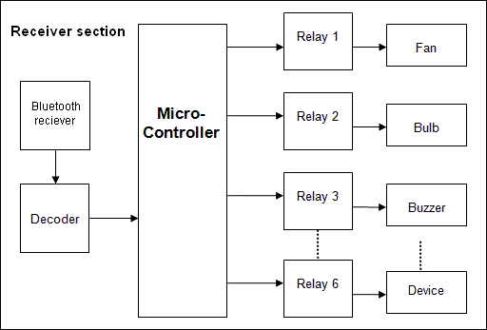
BLOCK DIAGRAM(Bluetooth to appliance)

Slide 9
WORKING PRINCIPLE
We are using ALICE-a voice controlled chatbot to control the home appliances.
The chatbot on receiving command from the user communicates with the microcontroller in the Arduino board and switches the appliances on or off.
It also tells whether you have connected any appliances or not and also the current on/off state of the appliances.

Slide 10
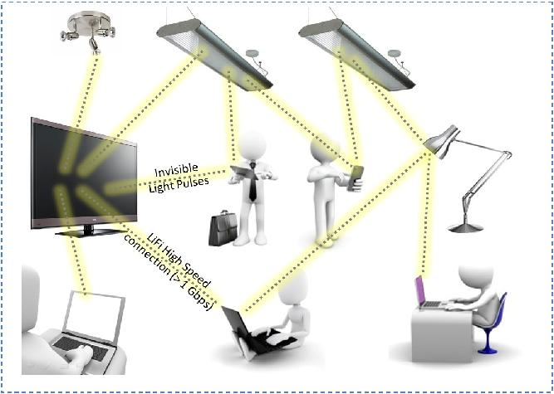
CONCLUSION
If this technology can be put into practical use ,every smartphone can be used as a remote control device to control almost every home appliance.
Anyone can use ALICE to smartly control the home appliance.
Easy and convenient for all age groups.
We can add fingerprint security system for security purpose.

Slide 11
REFERENCES
https://en.wikipedia.org/wiki/Home_automation
https://diyhacking.com/diy-android-home-automation/y
https://electronicsforu.com/electronics-projects/hardware-diy/arduino-home-automation-system-android/2

